Slide 1
Pharmacy Management System (web application)
DEVELOPED BY:
MD. A.k azad (1415103004)
md. Inzamamul haque (14152103006)
Md. Rasel hossain (14152103023)
Supervised By:
MIJANUR RAHAMAN
Assistant Professor
Department of CSE,BUBT

Slide 2
INTRODUCTION
This project concerned about developing a Pharmacy Management System. The pharmacy management system is also known as the pharmacy information system, is a system that organized & maintains the medication use process within pharmacies. Easily Calculate quantity and how much types drugs in your store.

Slide 3
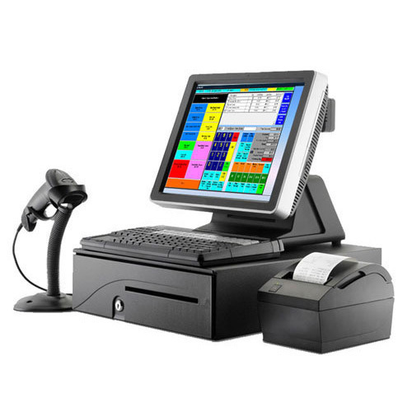
INTEGRATION WITH POS
A point of sale system, or POS, is the place where your customer makes a payment for products or services at your store. Simply put, every time a customer makes a purchase at your store, they're completing a point of sale transaction. As well as our application is integrate with pos

Slide 4
SYSTEM CONFIGURATION
To able to use this application, you will need
Computer with any operating system.
Internet browser such as google chrome, mozila firefox , operamini e.t.c
any device with supported browser.
Minimum 1 GB ram .
Internet enabled device

Slide 5
SOFTWARE & TOOLS
To developed this app, we have used-
Php storm, notepad ++
Web browser google chrome.
For frontend:
Html, Css, JavaScript, bootstrap.
For backend:
Php, MySQL, Xampp server.

Slide 6
FEATURES
Our project have this features-
Retailer can sell medicine from home.
Add multiple medicine into one invoice
When medicine will be add invoice if customer want to cancel this medicine he can do this and quantity increase or decrease possible from invoice.
Seacrh invoice number and can do reorder from this invoice.
Print and download invoice.

Slide 7
CONTINUE… FEATURES
Calculate price and profit automatically.
Can get notification when quantity is low and date expiry medicine.
You can see dayli report this days and from to from.
Add medicine to the stock.
See the available stock from the medicine.
Search the medicine by different ways.
Update and delete medicine stock.

Slide 8
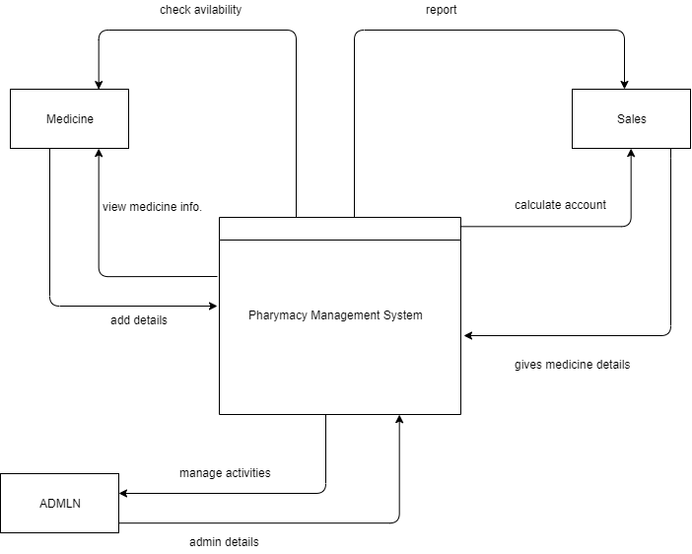
DATA FLOW DIAGRAM

Slide 9
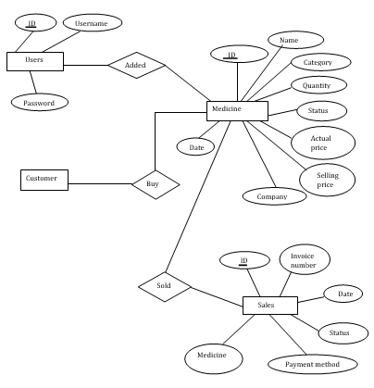
ENTITY RELATIONSHIP DIAGRAM

Slide 10
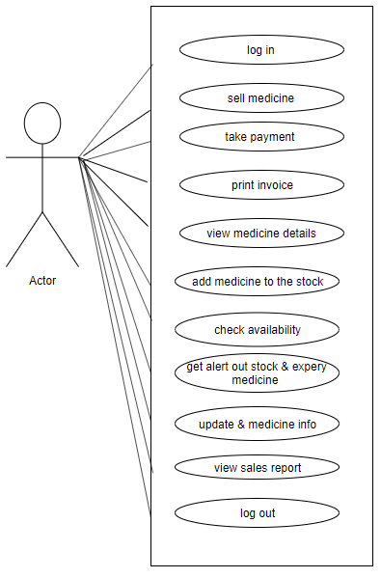
USE CASE DIAGRAM

Slide 11
LIMITATION
Our system have some limitation-
Our project database is not distributed.
This project can not use multiple branches in the same pharmacy it is for only one shop.

Slide 12
FUTURE PLANNING
In future these features will be added in our system:
Mobile Application.
Online payment.
Barcode Reader.
Social integration.
User Registration and store information.
We can give more advance software for pharmacy management System including more facilities

Slide 13
THANK YOU

